Slide 1

Halls of Air Flight Academy: Pilot Career Development Services for the 21st Century
CDR Hall, United States Navy

Slide 2
On the Agenda
Airline Industry Pilot Needs
Airline Pilot Training Requirements
HAFA’s Approach
The Way Ahead

Slide 3
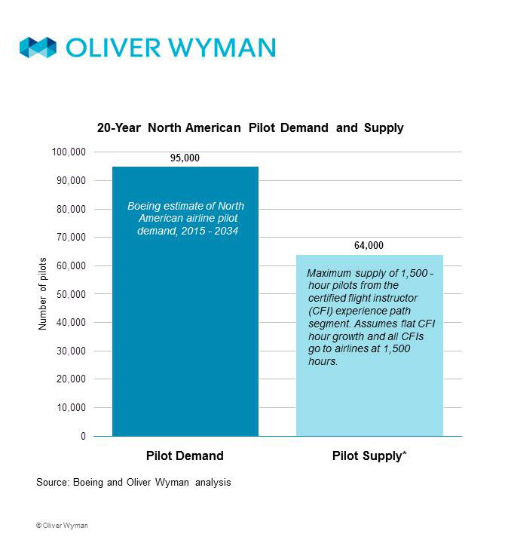
Industry demand
Average age of airline pilots is 50
American Airlines mandatory retirements
  2020: 535
  2021: 580
  2022: 647
  2023: 704
  2024: 717
International demand for US pilots

Slide 4
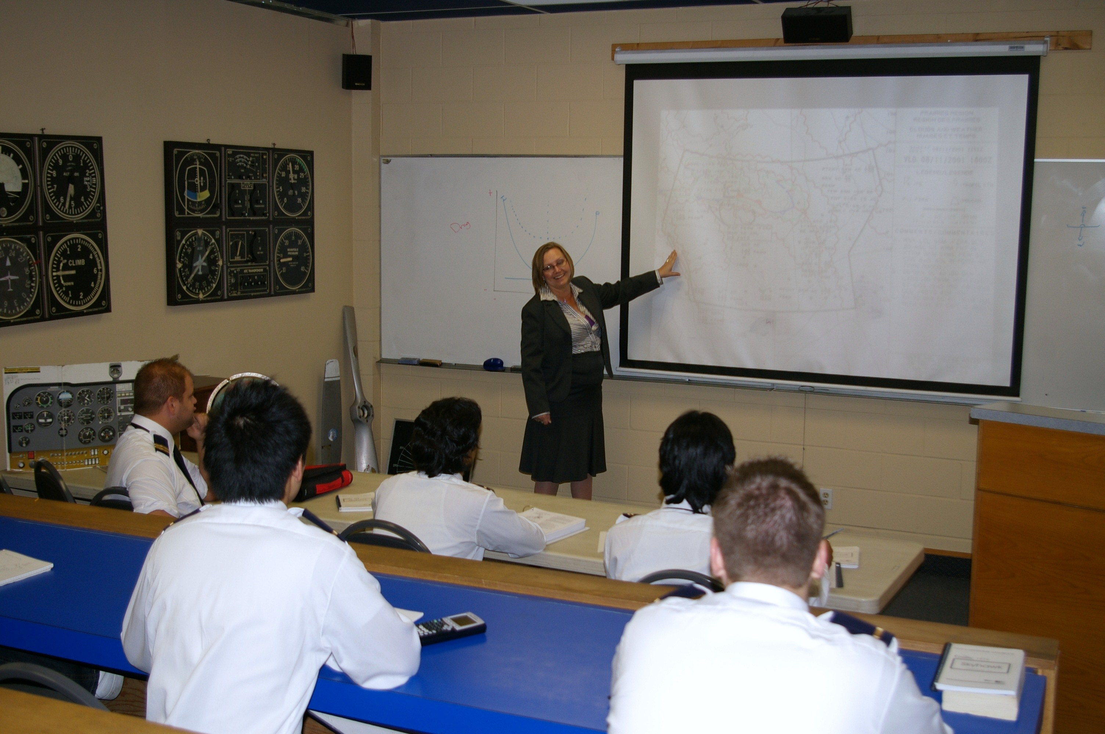
Pilot certification requirements
Airlines require an FAA Air Transport Pilot (ATP) certification
  Certification Training Program
    30 hours of classroom instruction
    10 hours in large aircraft simulator
  ATP Checkride

Slide 5
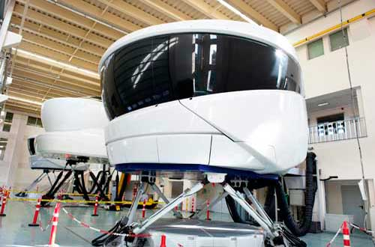
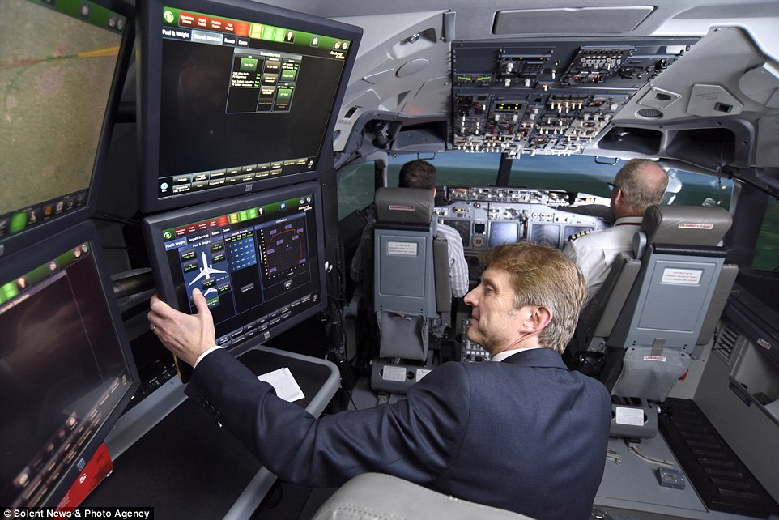
Level c simulator

Slide 6
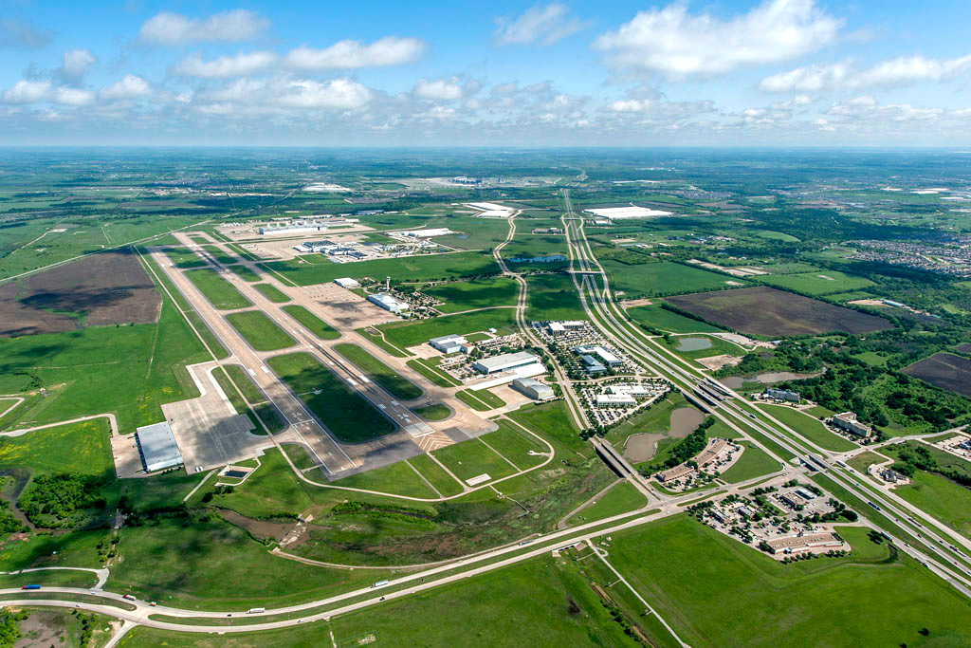
HAFA’s Method
Provide Certification Training Program curriculum
Rent simulator time from airline training facilities
Train pilots for successful ATP checkride/type rating
Assist in hiring through industry partners

Slide 7
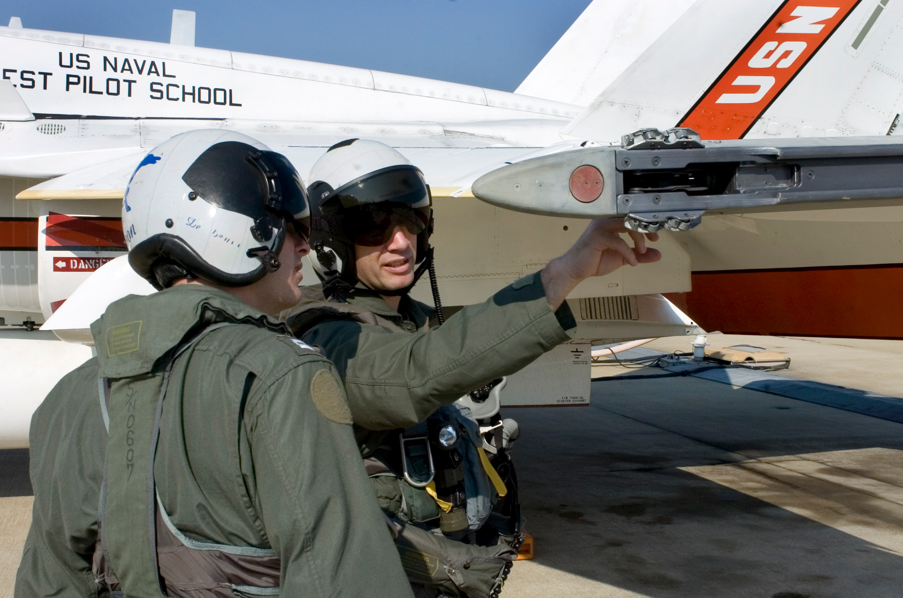
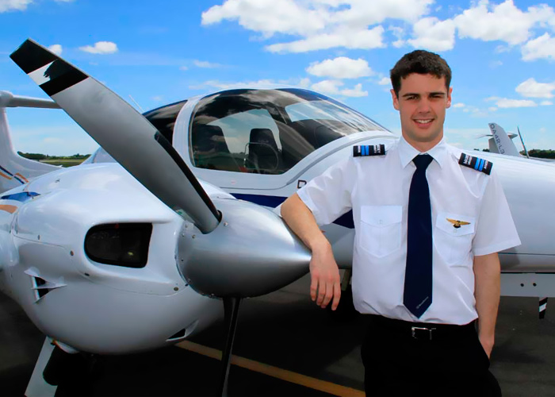
HAFA’s Target market
Military Pilots with Pilot-in-Command experience
  GI Bill funding expertise
Certified Flight Instructors with >1,500 hours flight time

Slide 8
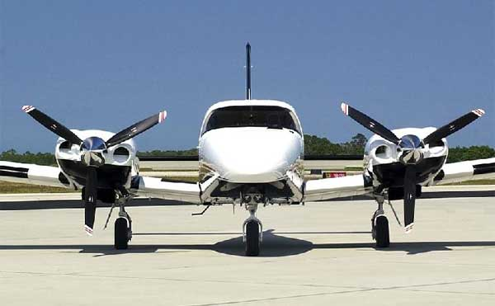
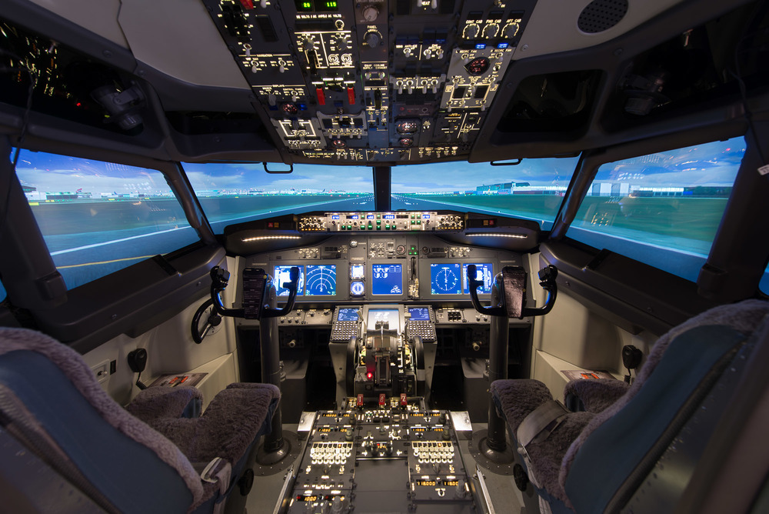
Future expansion
Fleet of training aircraft
Purchase Level C simulator

Slide 9

How you can join hafa
Equity funding for stage one
  Company will seek profitability before further expansion
Spread the word!

Slide 10

Questions?

